Slide 1
Introduction to AI
Lyernisha S R
Lecturer, FICT

Slide 2
Depth-limited Search
A depth-limited search algorithm is similar to depth-first search with a predetermined limit.
Depth-limited search can solve the drawback of the infinite path in the Depth-first search.
In this algorithm, the node at the depth limit will treat as it has no successor nodes further thus the search ends.
Depth-limited search can be terminated with two Conditions of failure:
Standard failure value: It indicates that problem does not have any solution.
Cutoff failure value: It defines no solution for the problem within a given depth limit.

Slide 3
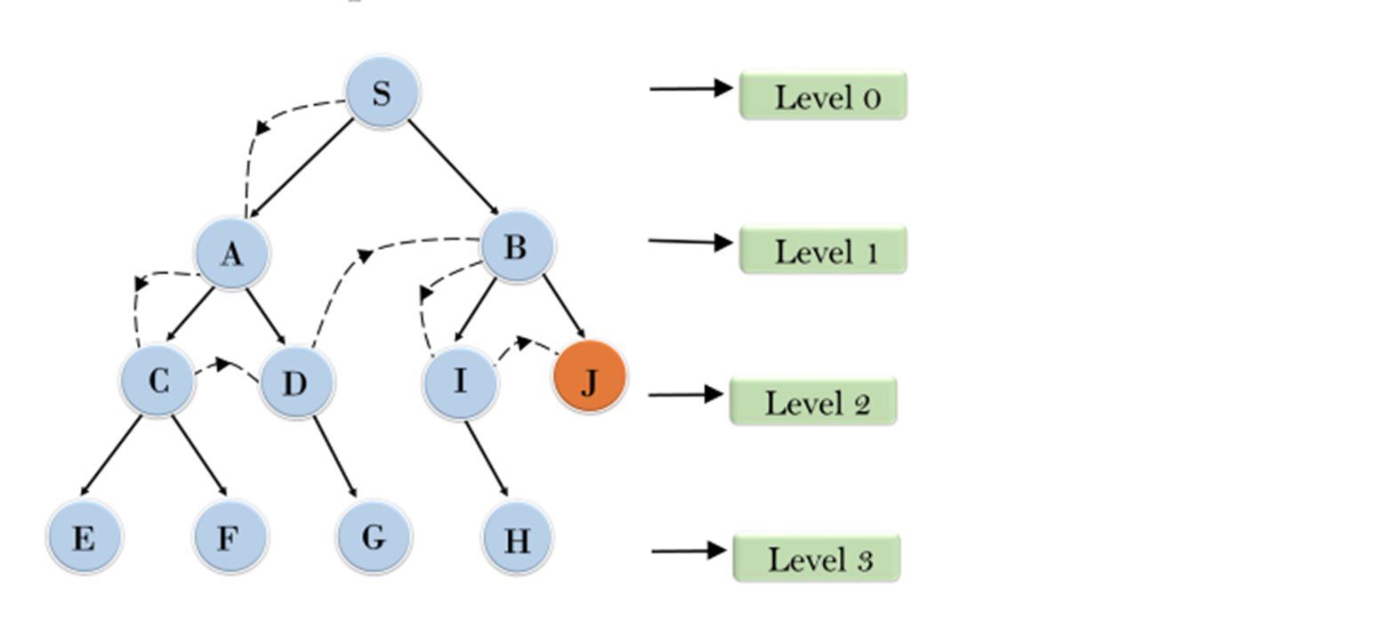
Example

Slide 4
Depth-limited Search
Advantages:
Depth-limited search is Memory efficient.
Disadvantages:
Depth-limited search also has a disadvantage of incompleteness.
It may not be optimal if the problem has more than one solution.

Slide 5
Properties of DLS
Completeness: DLS search algorithm is complete if the solution is above the depth-limit.
Time Complexity: Time complexity of DLS algorithm is O(b^{ℓ}).
Space Complexity: Space complexity of DLS algorithm is O(b×ℓ).
Optimal: Depth-limited search can be viewed as a special case of DFS, and it is not optimal even if ℓ>d , else optimal i.e. if ℓ<d.

Slide 6
Uniform Cost Search
Uniform-cost search is a searching algorithm used for traversing a weighted tree or graph.
This algorithm comes into play when a different cost is available for each edge.
The primary goal of the uniform-cost search is to find a path to the goal node which has the lowest cumulative cost.
Uniform-cost search expands nodes according to their path costs form the root node.
It can be used to solve any graph/tree where the optimal cost is in demand.
A uniform-cost search algorithm is implemented by the priority queue. It gives maximum priority to the lowest cumulative cost.
Uniform cost search is equivalent to BFS algorithm if the path cost of all edges is the same.

Slide 7
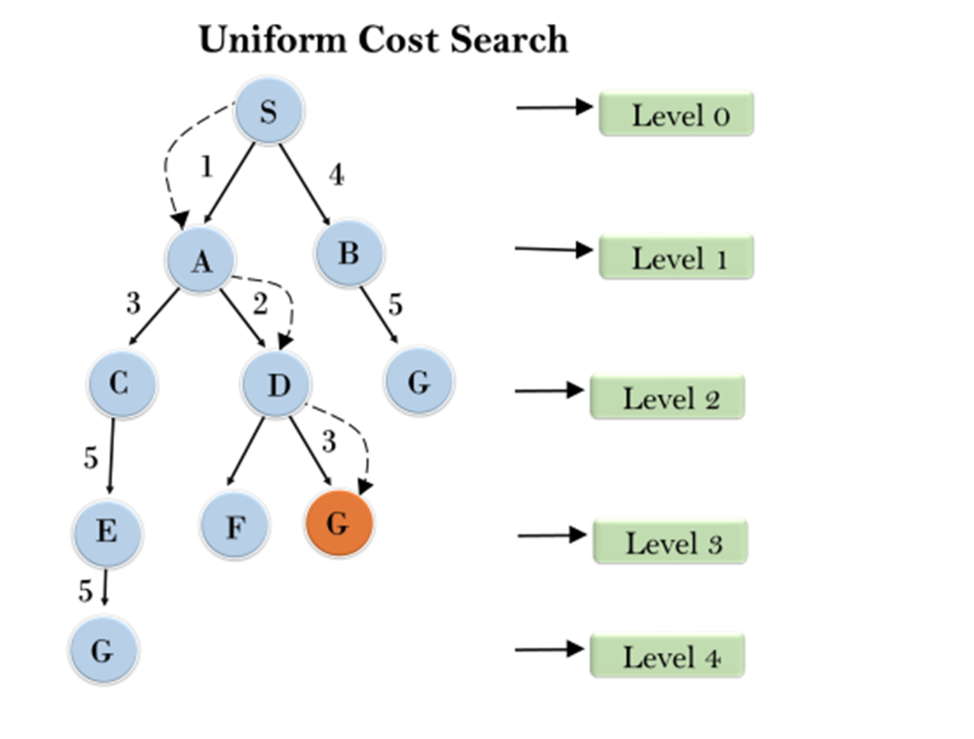
Example UCS

Slide 8
Uniform Cost Search
Advantages:
Uniform cost search is optimal because at every state the path with the least cost is chosen.
Disadvantages:
It does not care about the number of steps involve in searching and only concerned about path cost. Due to which this algorithm may be stuck in an infinite loop.

Slide 9
Properties of UCS
Completeness:
Uniform-cost search is complete, such as if there is a solution, UCS will find it.
Time Complexity:
Let C* is Cost of the optimal solution, and ε is each step to get closer to the goal node. Then the number of steps is = C*/ε+1. Here we have taken +1, as we start from state 0 and end to C*/ε.
Hence, the worst-case time complexity of Uniform-cost search is O(b^{1 + [C*/ε]}).
Space Complexity:
The same logic is for space complexity so, the worst-case space complexity of Uniform-cost search is O(b^{1 + [C*/ε]}).
Optimal:
Uniform-cost search is always optimal as it only selects a path with the lowest path cost

Slide 10
Iterative Deepening Depth-First Search (IDDFS)
Depth-First Iterative Deepening, or DFID (also called Iterative Deepening Search or IDS), is an exhaustive search technique that combines depth-first with breadth-first search.
The DFID algorithm involves repeatedly carrying out depth-first searches on the tree, starting with a depth-first search limited to a depth of one, then a depth-first search of depth two, and so on, until a goal node is found.
That is DFS is applied to the root node, if it is not goal node move to the next level and continue applying dfs in next level
Each level is visited in each iteration.

Slide 11
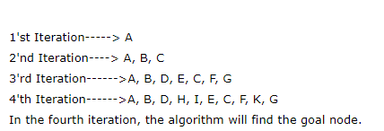
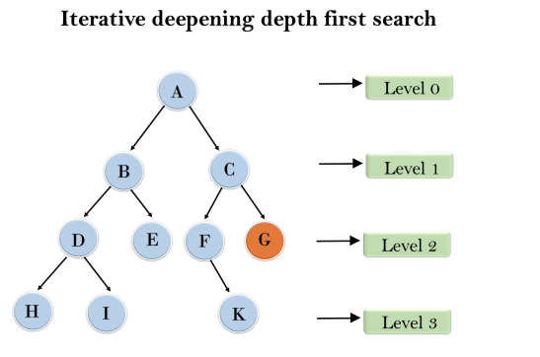
Example
Following tree structure is showing the iterative deepening depth-first search. IDDFS algorithm performs various iterations until find the goal node. The iteration performed by the algorithm is given as
Note: In the 3rd iteration itself algorithm finds the goal node G. It can be set to stop at finding the initial solution or can be set to search the search tree fully to find other solutions if any exist.

Slide 12
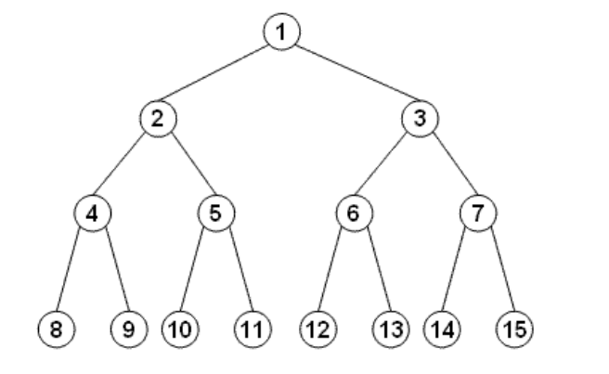
QUESTION 1
For the following Search space ,suppose the goal state is 11. List the order in which nodes will be visited for breadth-first search, depth-limited search with limit 3, and iterative deepening search

Slide 13
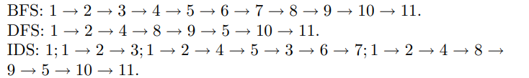
SOLUTION

Slide 14
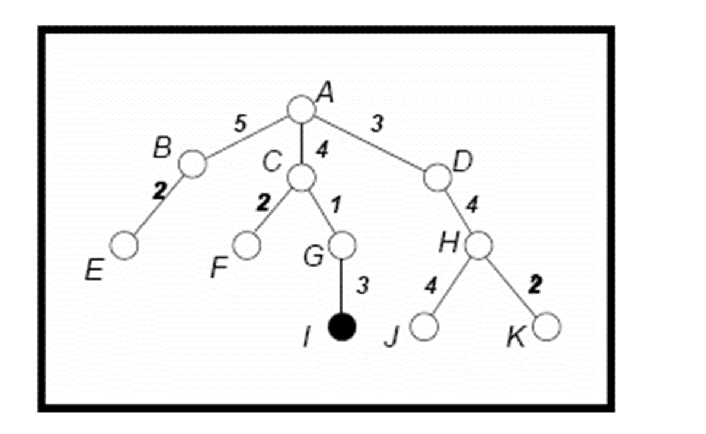
QUESTION 2
For the following tree, show the order of nodes visited for breadth-first search, depth-first search, uniform cost search, and iterative deepening search . The goal node is I and the numbers next to the edges indicate the associated cost

Slide 15
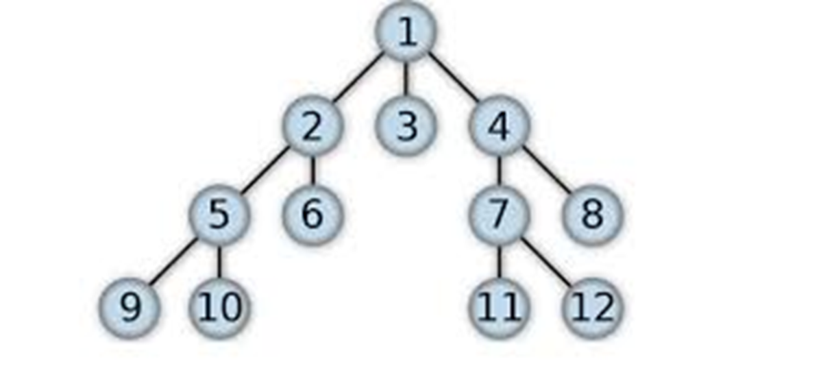
QUESTION 3
For the following tree, show the order of nodes visited for breadth-first search, depth-first search, depth limited search (l=3), and iterative deepening search

Slide 16
Thankyou

